Slide 1

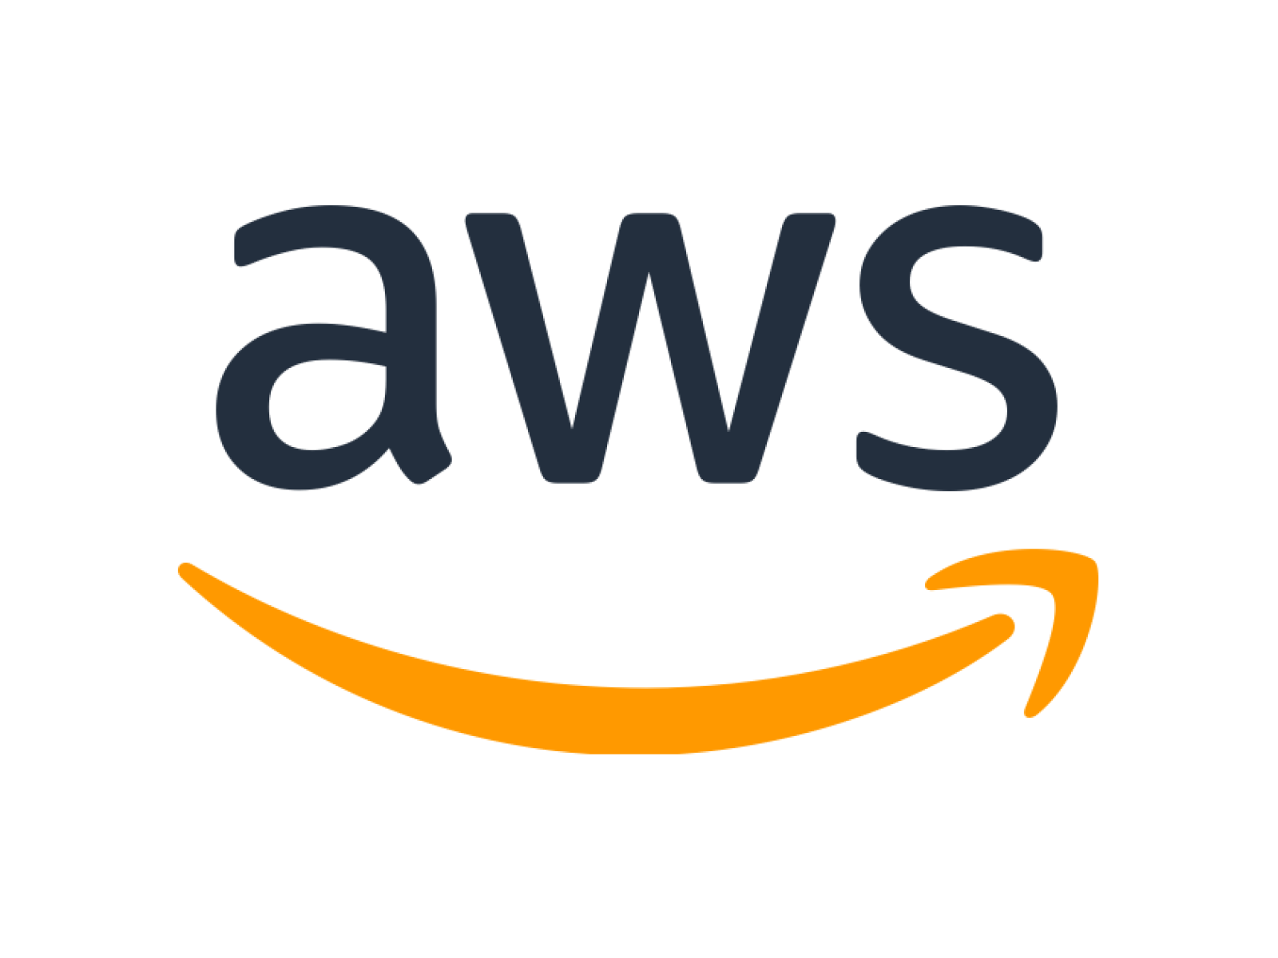
Amazon Web Services Infrastructure Essentials

Slide 2
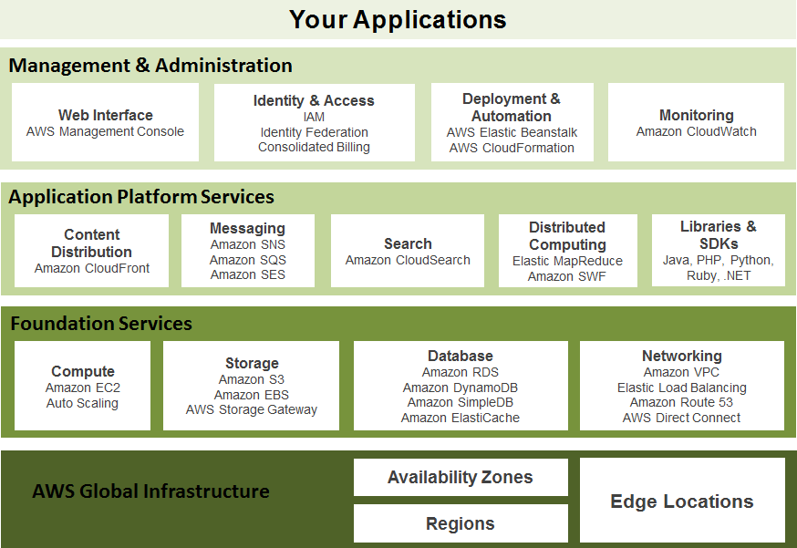
Amazon Web Services

Slide 3
Amazon Free Tier
Amazon Web Services are generally not free; however, AWS does provide a Free Usage Tier for marketing purposes which expires after 12 months from sign up.
The services available in the Free Usage Tier also have restrictions/quotas on usage.
The majority of the quotas are monthly.
Other restrictions may apply aside from quotas (e.g. only micro instances are available in the Free Tier)
Be aware that when you sign up for the Free Tier, you are signing up for all of AWS.
Docs:Free Usage Tier
Useful:AWS Simply Monthly Calculator
Amazon Web Services Student Tutorial

Slide 4
Amazon Machine Images (AMIs)
Essentially a virtual machine image or snapshot
”An Amazon Machine Image (AMI) is a special type of pre-configured operating system and virtual application
software which is used to create a virtual machine within the Amazon Elastic Compute Cloud (EC2). It serves as the basic unit of deployment for services delivered using EC2.”
AWS supports the following virtual image types for import/export: VMware ESX VMDK images, VMware ESX OVA (export only), Citrix Xen VHD images and Microsoft Hyper-V VHD images.Not free in practice!
Refs:Amazon Machine Images List Refs:VM Import/Export,Import/Export FAQs
David Palma Joseph Snow
Amazon Web Services Student Tutorial

Slide 5
Free Tier Contd...
Your Free Tier usage quotas are used up first for billing (you will not be charged for this usage)
However, once your quotas are exceeded, you will be billed at normal rates for any further usage
Also, any service which you use that is not included in the Free Usage Tier are also billed at normal rates. There is no warning about non-free usage.
AWS does not provide any way to discontinue services once your free quotas are used up, it is your responsibility to keep track of your usage.
Keep in mind, if you get charged due to negligence or
”accidents”, you still owe Amazon for the resources you used.

Slide 6
Elastic Compute Cloud (EC2)
EC2 is the basic fundamental block around which the AWS are structured.
EC2 provides remote operations of virtual machines (VM) on Amazon’s infrastructure.
A single VM is called an instance, and there are different instance types that differ in their available resources.
A micro instance is the only EC2 instance type that is free and is also the most underpowered instance (613MB memory).
The EC2 micro instance type is the least reliably provisioned; when demand on Amazon’s infrastructure is high, the micro instance gets the lowest priority.
Docs:Instance Types,Micro Instances

